Slide 1

Using GCSE Pod
Preparing for Yr. 11 Exams
To help guide your revision

Slide 2
Connecting PLCs and GCSE Pod
Once you have used your PLCs in each subject to identify topics where you want to concentrate your revision you can use GCSE Pod to create Playlists
When you create your playlists you are aiming to fill in the gaps in your knowledge you have identified through your PLCs and mock exams
Filling in the gaps in your knowledge.

Slide 3
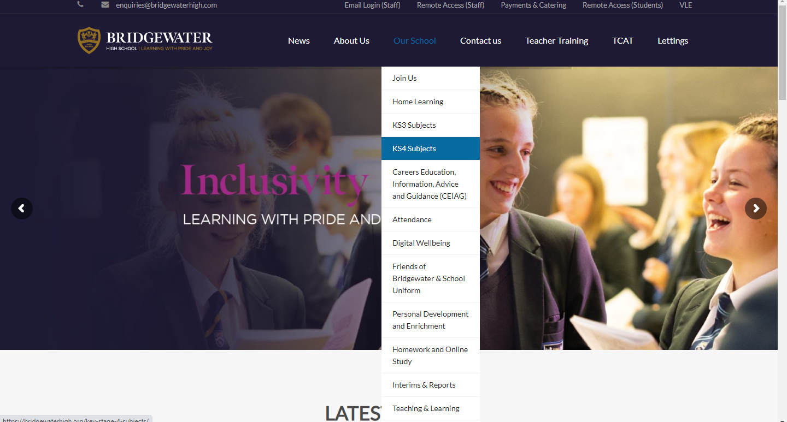
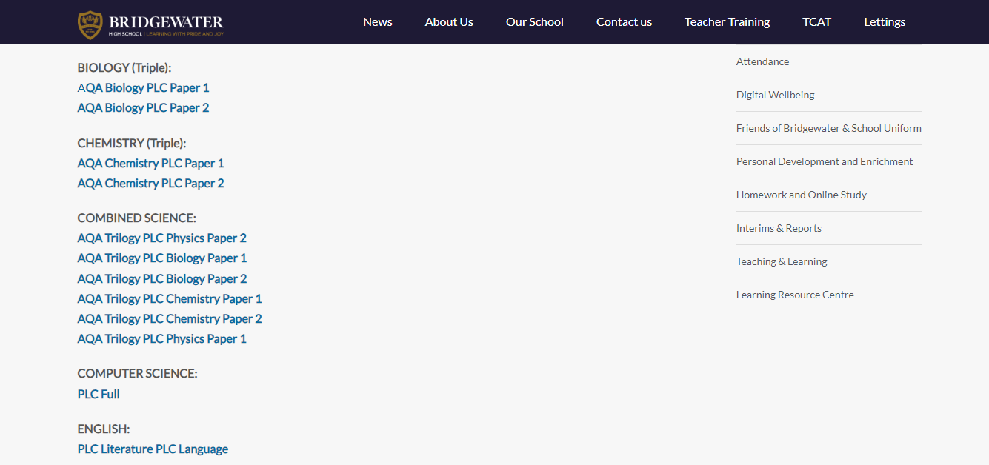
Reminder ! Where can you find all your PLCs?
On the school website click on ‘our school’ and then ‘KS4 subjects’.
On the KS4 page, you will see a list of all the subjects. Underneath each subject will be the PLC link.

Slide 4
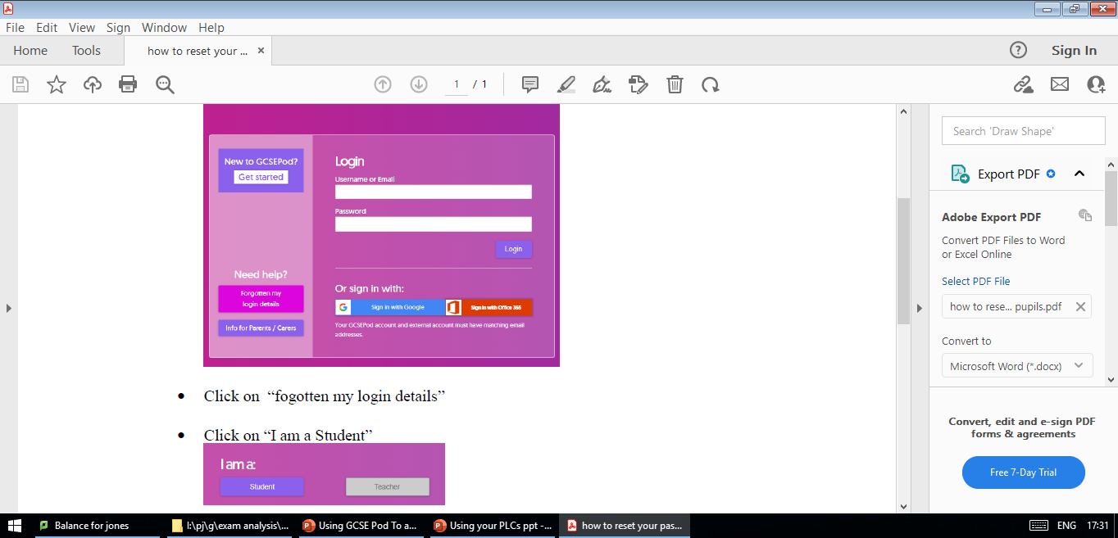
What if you haven’t used GCSE Pod before…?
Click on the New to GCSE Pod Get Started tab
Follow the instructions to register and log in

Slide 5
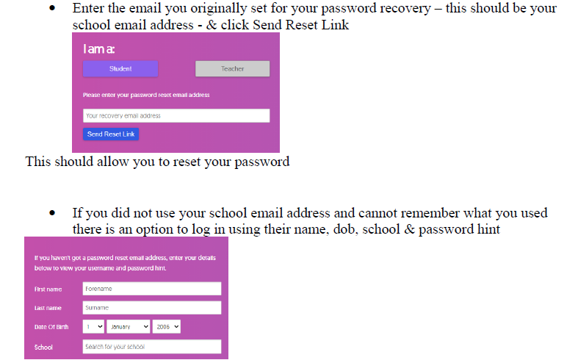
What if you cant remember how to login to GCSE Pod…?

Slide 6
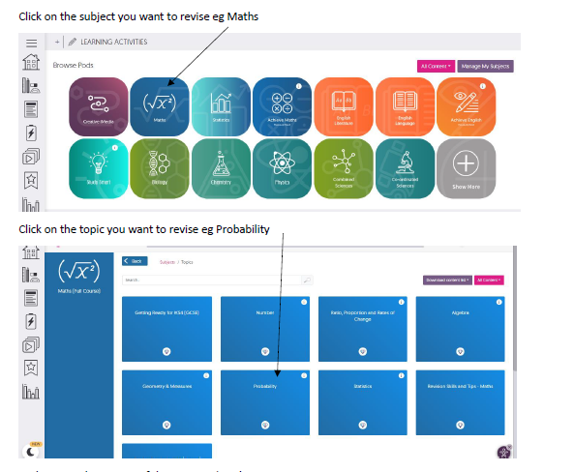
This is how to use GCSE Pod to create playlists…

Slide 7
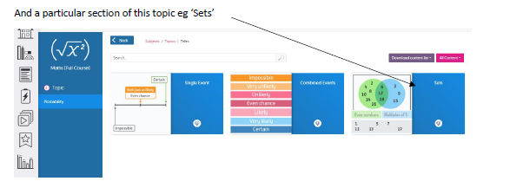
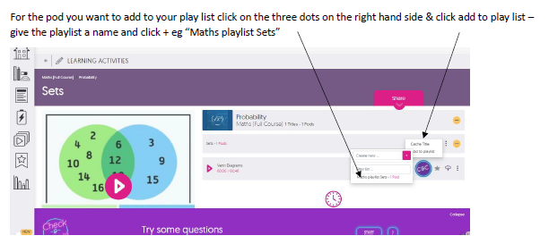
This is how to use GCSE Pod to create playlists…

Slide 8
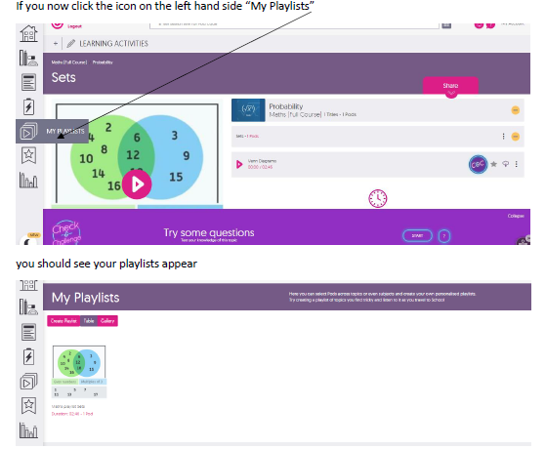
This is how to use GCSE Pod to create playlists…

Slide 9
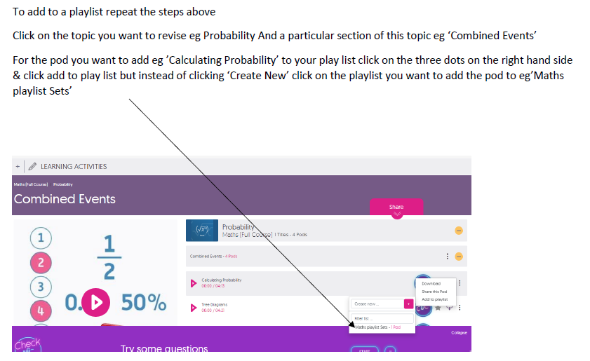
This is how to use GCSE Pod to create playlists…

Slide 10
Time to start…
Get your PLC for one of your subjects
log into GCSE Pod
Find your subject
Select the pods relevant to the topics you need to revise the most
Create a play list and start putting the pods onto it

