Slide 1

Using Sparx & Maths Genie
Preparing for Yr. 11 Exams
To help guide your Maths revision

Slide 2
Connecting your Maths PLC and Sparx
Once you have used your Maths PLC to identify topics where you want to concentrate your revision you can use Sparx to practice these topics
Remember you are aiming to fill in the gaps in your knowledge you have identified through your Maths PLC and mock exams
Filling in the gaps in your knowledge.

Slide 3

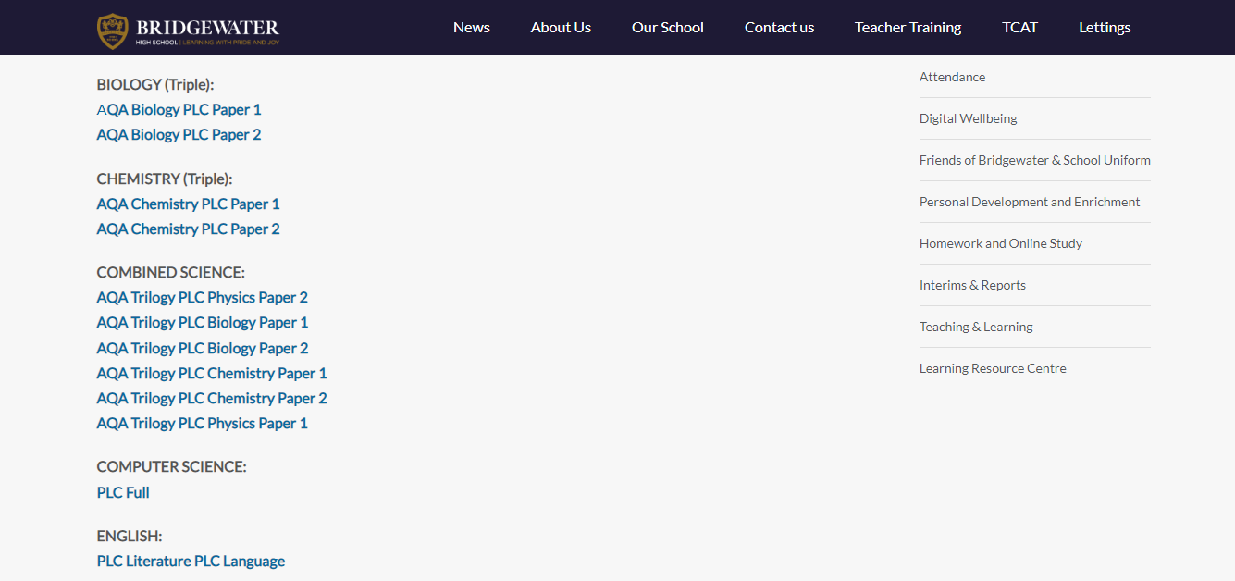
Reminder ! Where can you find all your PLCs?
On the school website click on ‘our school’ and then ‘KS4 subjects’.
On the KS4 page, you will see a list of all the subjects. Underneath each subject will be the PLC link.

Slide 4
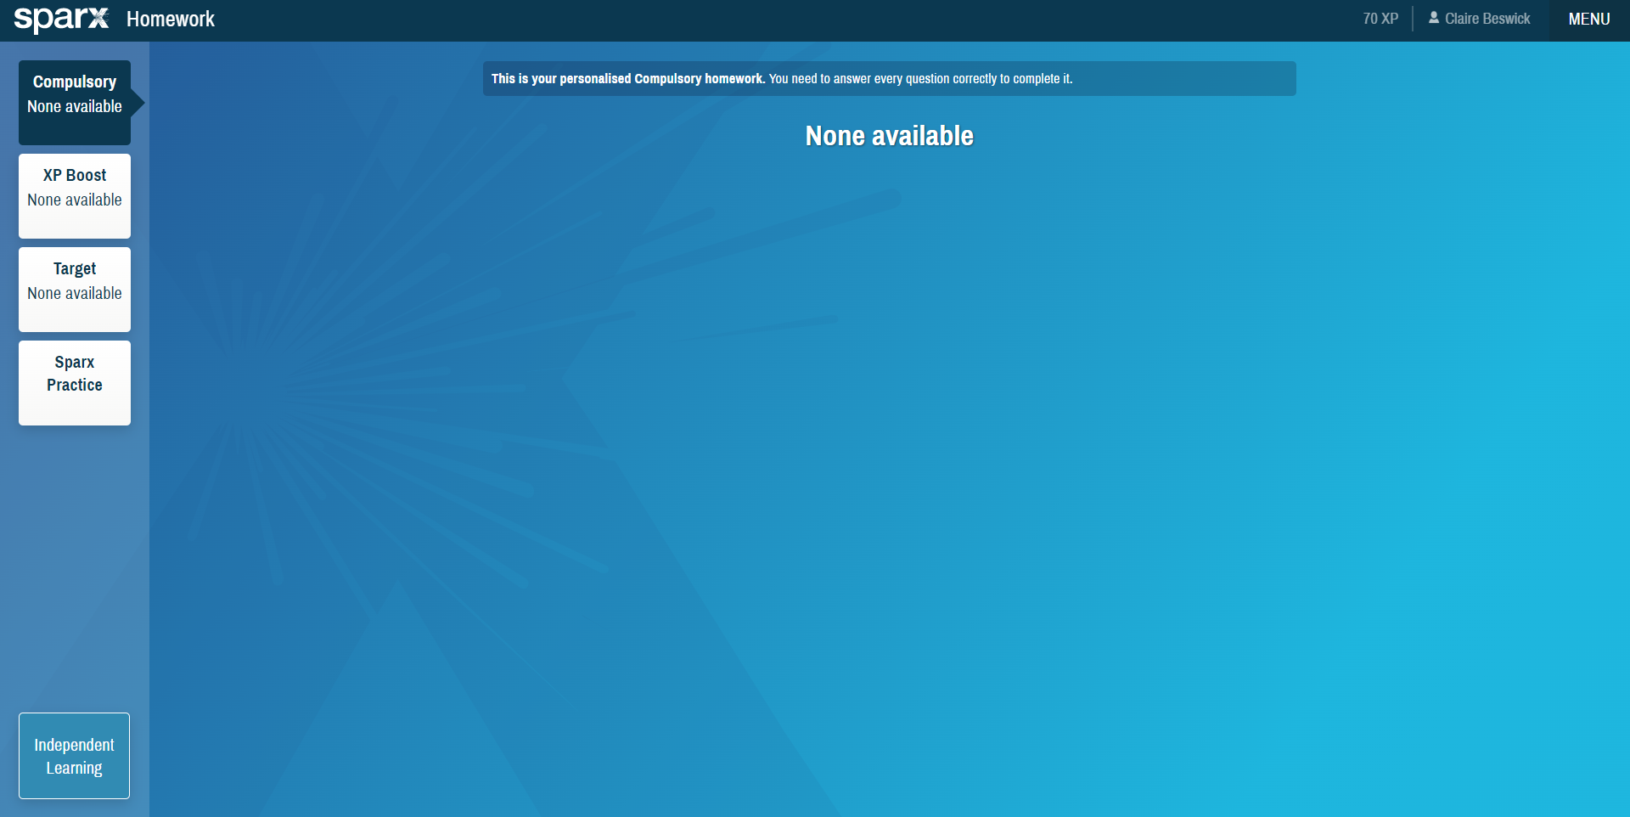
Click independent learning

Slide 5
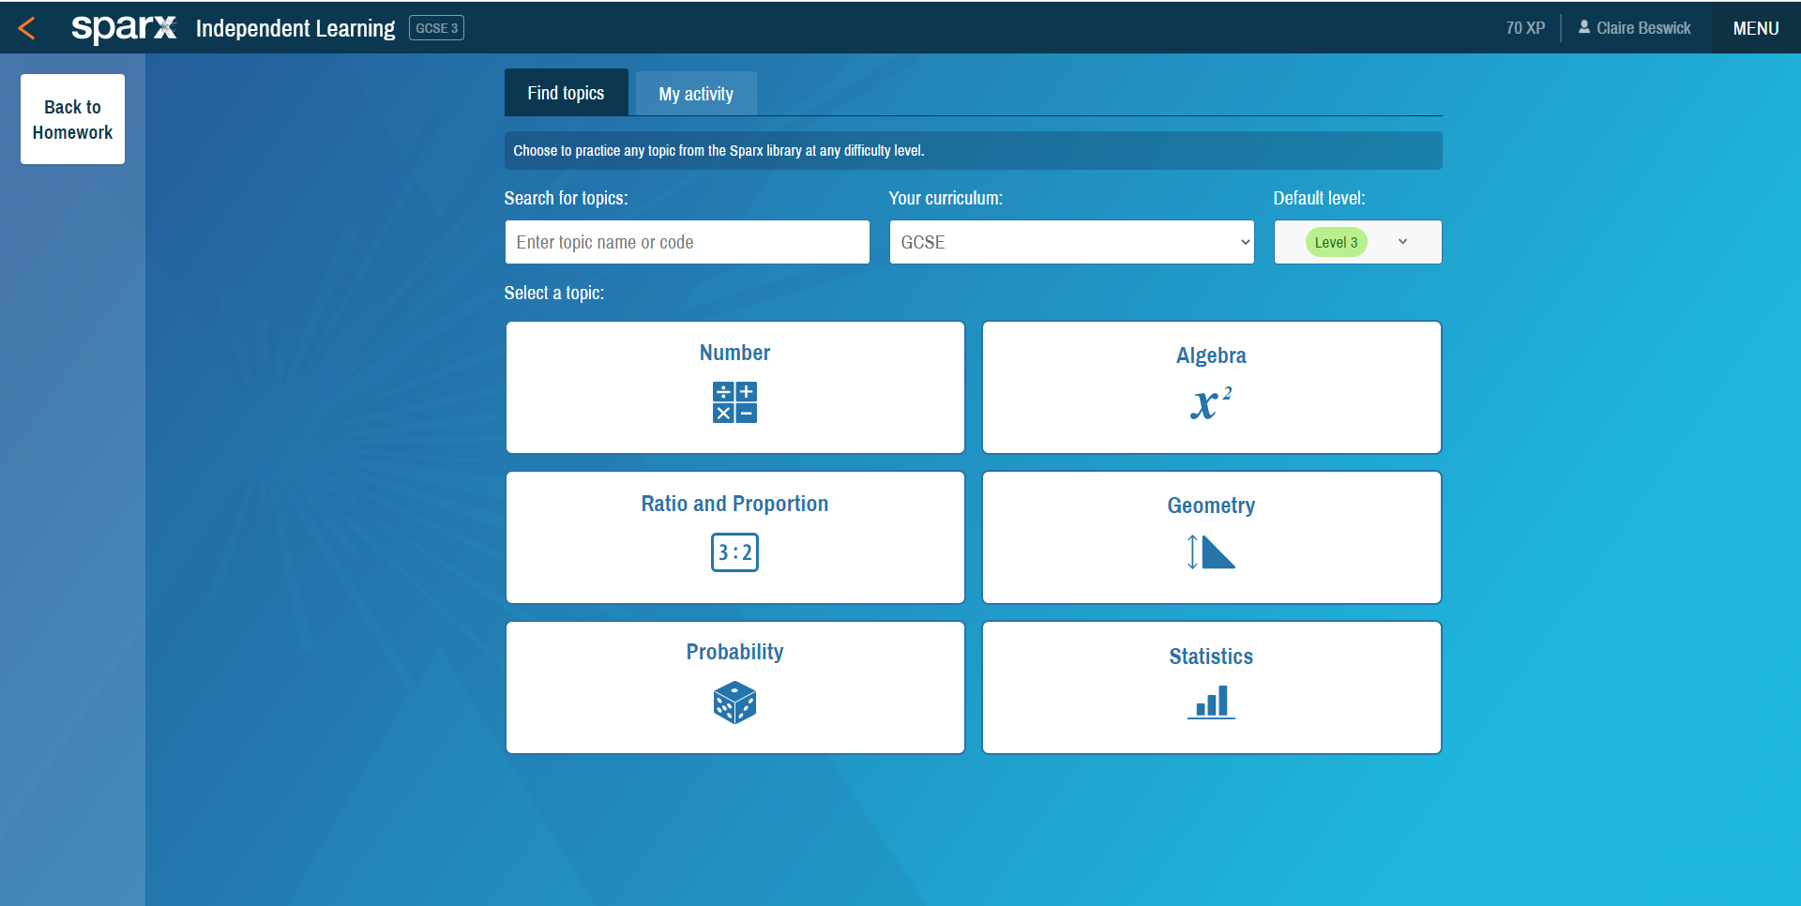
2) Choose the right level of difficulty
1) Choose ‘GCSE’ for your curriculum
3) Choose which topic to revise
4) After you have revised the topic you might want to change its RAG rating on your PLC…?

Slide 6
Mathsgenie

Slide 7
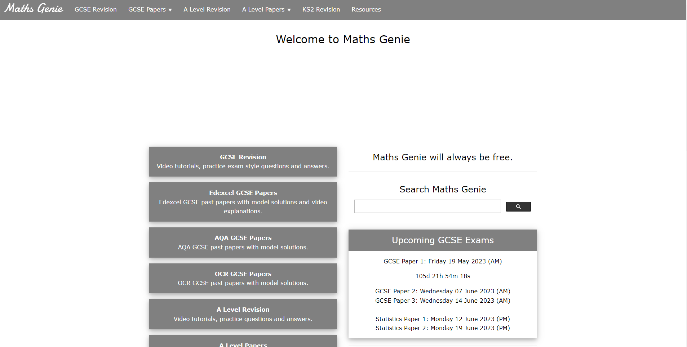
Using Mathsgenie to practice past papers
Choose EDEXCEL
GCSE Papers

Slide 8
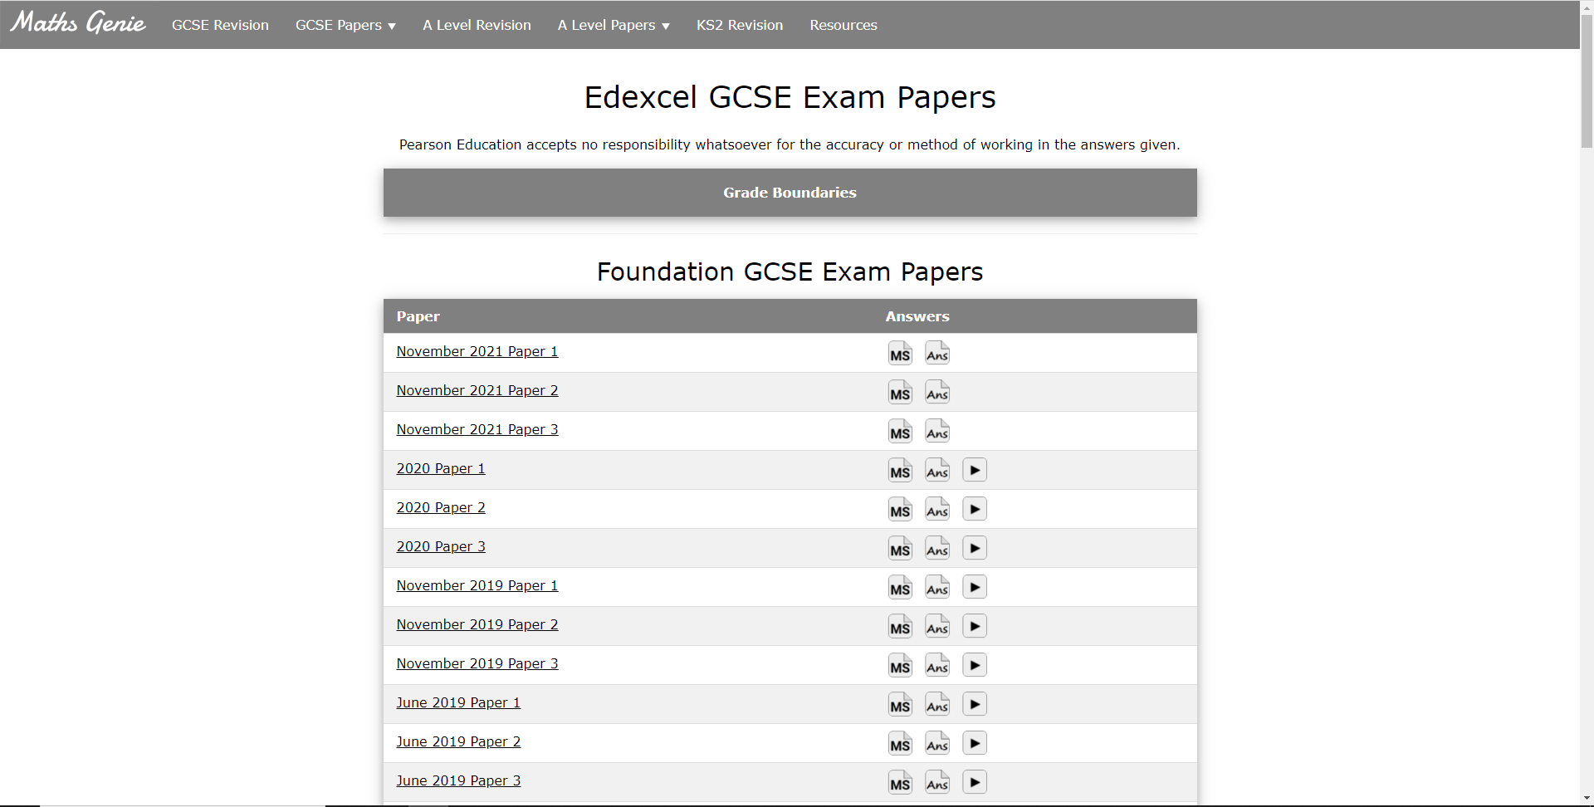
Choose a paper
There are Higher papers too if you scroll down

Slide 9
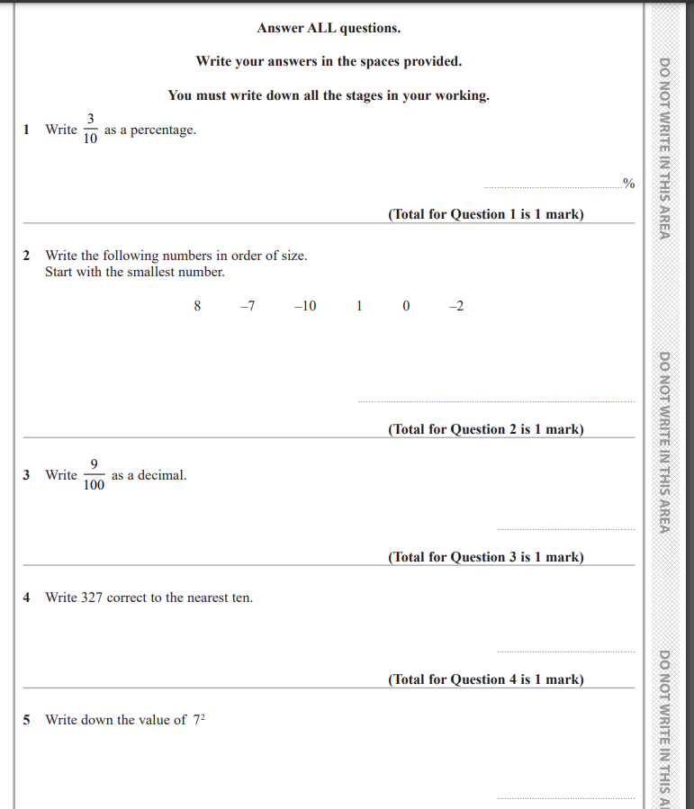
Work through the questions in the back of your maths book
You don’t need to print the past paper out

Slide 10
Click ‘ans’ for the answers

Slide 11
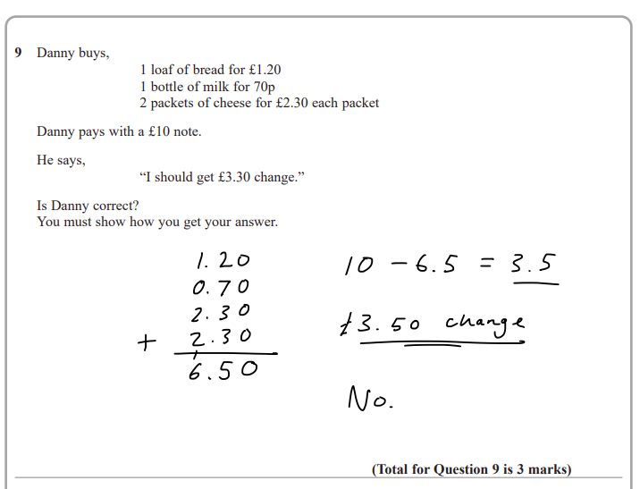
For any questions that you got wrong you can use the solutions to see where you went wrong
For any questions that you left out you can use the solutions to find out how to do it
At the end of the paper you might want to change some of the RAG ratings in your Maths PLC depending how you got on with certain questions/topics
To revise those topics go back to Sparx Maths and click independent learning…

Slide 12
Time to start on Sparx…
Get your Maths PLC
log into Sparx
Click independent learning (bottom left)
Choose GCSE
Choose the right level – Higher or Foundation
Based on your PLC choose which topic you want to revise

