Slide 1
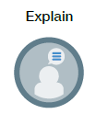
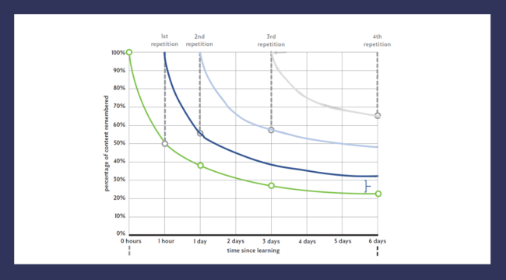
Ebbinghaus’ Forgetting Curve
We often feel frustrated with ourselves for forgetting information. In the run up to exams, this can lead to feelings of stress and can have a negative impact on our confidence.
Learning about how we forget can help us feel less negative about our memory and can help us to take steps to improve how much we remember.
German Psychologist Hermann Ebbinghaus developed the forgetting curve to illustrate how information is forgotten over time.
The Green line shows the rate at which we naturally forget new information.
Notes:
This is very simplified - value of retrieval practice will be explained on next slide.
https://teachlikeachampion.org/blog/an-annotated-forgetting-curve/

Slide 2
Ebbinghaus’ Forgetting Curve
This chart also shows the impact of going over key information repeatedly.
Each time that we revisit information we are able to remember more.
Source : https://teachlikeachampion.org/blog/an-annotated-forgetting-curve/

Slide 3

Implications for Revision
In pairs, discuss how you might consider the forgetting curve when planning your revision.
What strategies would be helpful / not helpful for revision?
So, to revise effectively, you need to find ways to interrupt the forgetting curve.
Notes:
This is very simplified but should be sufficient detail for students to begin to think about how some forms of revision will be more / less effective. – retrieval practice and spaced revision is key here – memorizing key information – repeated practice – to embed knowledge into long term memory.

Slide 4
For each statement, decide which is the better revision strategy
Statement | Revision Strategy A | Revision Strategy B
1. It is natural to struggle to remember new information. | Revisit key information regularly but don’t just read notes. Use self quizzing or flashcards to test yourself and don’t be disheartened if it seems difficult. | Read through notes on a regular basis and important information should stick in your mind.
2. The largest drop in memory happens soon after we are introduced to new information. | Focus on revising information soon after you have learned it in class and just before exams. | Revisit information regularly. Plan your revision so that you go over topics several times. Accept that recalling information is often challenging. It doesn’t mean your memory is bad or that you can’t revise just that you need to go over things repeatedly.
3. It is easier to remember things that have meaning. | You will be less confused if you try to learn each new piece of information on its own and just repeat it until you remember it. | Try to make links between new knowledge and existing knowledge. Draw concept maps, flow charts or timelines to explain how ideas are linked together.
4. How you feel affects how well you remember. | Doing well in tests will increase confidence so it is worth cramming before exams. | You are more likely to remember well if you are well fed, hydrated and rested so plan your revision timetable to avoid cramming.
5. Ebbinghaus discovered that if we keep reviewing information over time the rate at which we forget it decreases. | You will remember more if you space out your revision for each topic. So for example, plan to spend an hour on a topic in 4, 15 minute chunks rather than in one session. | GCSE content is challenging so it is easier to focus for an hour revising one topic then to move on to another topic.
6. The way information is presented affects learning. | Use lots of colours to make notes look nice. | Ensure that notes are organised and laid out clearly.
7. Be positive about challenge – identify gaps to fill them | Use Personalised Learning checklists, exam specifications and exam feedback to see where your strengths and weaknesses are in terms of subject knowledge. | It is better to focus on your favourite topics. If you enjoy them you are more likely to remember them.
Notes:
Students can discuss these in pairs before talking through answers on next slide.

Slide 5
Answers - For each statement, decide which is the better revision strategy
Statement | Revision Strategy A | Revision Strategy B
1. It is natural to struggle to remember new information. | Revisit key information regularly but don’t just read notes. Use self quizzing or flashcards to test yourself and don’t be disheartened if it seems difficult. | Read through notes on a regular basis and important information should stick in your mind.
2. The largest drop in memory happens soon after we are introduced to new information. | Focus on revising information soon after you have learned it in class and just before exams. | Revisit information regularly. Plan your revision so that you go over topics several times. Accept that recalling information is often challenging. It doesn’t mean your memory is bad or that you can’t revise just that you need to go over things repeatedly.
3. It is easier to remember things that have meaning. | You will be less confused if you try to learn each new piece of information on its own and just repeat it until you remember it. | Try to make links between new knowledge and existing knowledge. Draw concept maps, flow charts or timelines to explain how ideas are linked together.
4. How you feel affects how well you remember. | Doing well in tests will increase confidence so it is worth cramming before exams. | You are more likely to remember well if you are well fed, hydrated and rested so plan your revision timetable to avoid cramming.
5. Ebbinghaus discovered that if we keep reviewing information over time the rate at which we forget it decreases. | You will remember more if you space out your revision for each topic. So for example, plan to spend an hour on a topic in 4, 15 minute chunks rather than in one session. | GCSE content is challenging so it is easier to focus for an hour revising one topic then to move on to another topic.
6. The way information is presented affects learning. | Use lots of colours to make notes look nice. | Ensure that notes are organized, easy to read and laid out clearly.
7. Be positive about challenge – identify gaps to fill them | Use Personalised Learning checklists, exam specifications and exam feedback to see where your strengths and weaknesses are in terms of subject knowledge. | It is better to focus on your favourite topics. If you enjoy them you are more likely to remember them.
Notes:
Students can discuss these in pairs before talking through answers on next slide.

