Slide 1











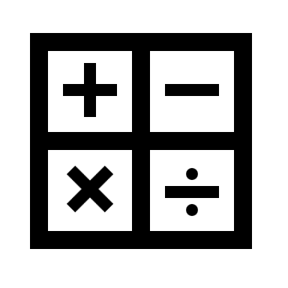

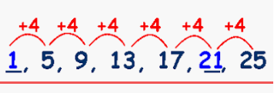
ROAD MAP TO
Paper 1:
Medicine:
18th and 19th century & Modern medicine
THE MATHS CURRICULUM
Vectors
Describing transformations
Geometric reasoning
Expanding and factorising
Conversion graphs
Gradients and lines
Show
that
Combined transformations
Product rule for counting
Multiplicative reasoning
Rearranging formulae
Nth term,
Quadratic sequences
Congruent triangles
Listing and
describing
Scatter diagrams
Transforming and constructions
Reasoning
Algebra
Graphs
Y11
Plans and elevations
Probability
Constructions
Functions
Speed and distance time graphs
loci
Algebraic reasoning
Non linear graphs
Expand & factorise
Non-calculator
Y=mx+c
Simultaneous equations
Solve
Algebraic fractions
Surface area
Cubic graphs
Angles in polygons
Trigonometry
Equations
Powers
Reflection
Rotation
Enlargement
Translation
Y10
Equations
Inequalities
Expressions
Percentages
Ratio
Fractions
Number work
Graphs
Probability
Area & Volume
Data
Curves
Angles
Graphs
Vectors
Surds
Transformations
Equations / angles
Trigonometry
Tree diagrams
SOHCAHTOA
Simultaneous equations
Change the subject of a formula
Ratio problems
Area / Circumference
Scatter graphs
Stem and leaf diagram
Reverse %
Quadratic graphs
Rates of pay
Inverse proportion
Prisms
Interest
HCF/LCM
Venn diagrams
Pythagoras
Curves
Probability
Using compasses
Constructions
Similarity
Algebra
Money
Graphs
Ratio and proportion
Fractions
Rates
Standard form
Number
Percentages
Area and volume
Algebra
Y9
Area
Circumference
Similar shapes
Y=mx+c
Speed
4 rules of fractions
Equations
Inequalities
Formulae
Pie charts
Expand & factorise
Circles
Sequences
Graphs
Compound units
Angles in parallel lines
Ratio problems
Direct proportion
Density
Inequalities
Percentage change
nth term
Units
Algebra
Graphs
Fractions
Area & volume
Equations
Percentages
Indices
Standard Form
Data
Angles
Probability
Measuring angles
Y8
Ratio &
Proportion
Sample space diagrams
Add and subtract fractions
Fractions
Angles and polygons
Multiply & divide fractions
Angles on a straight line
Expand & factorise
Y=mx+c
Laws of indices
Averages
Fractions and % of amounts
Negatives
Significant figures
Decimal places
Add, subtract, multiply, divide
Substitution
Factors & multiples
Speed, distance & time
Properties of number
Directed number Fractions and %
Perimeter and area
Graphs
Fractions, decimals & %
Number work
Averages & range
Rounding
Sequences
Equations Expressions
Y7
Prime numbers
Draw and interpret graphs
Converting FDP
Nth term
Geometric
Arithmetic

