Slide 1
















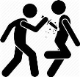

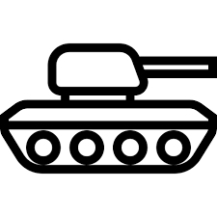








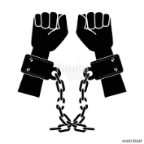


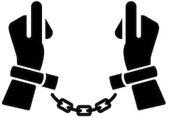
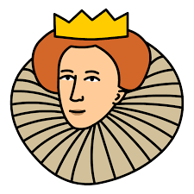






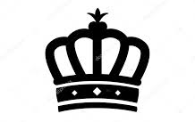




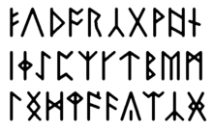
ROAD MAP TO
Paper 1:
Medicine:
18th and 19th century & Modern medicine
THE HISTORY CURRICULUM
Paper 3:
Germany:
Controlling Nazi Germany
(police state, [propaganda &
opposition) and life in Nazi Germany
Medical Developments
Reichstag Fire
Goodnight-Loving Trail
Hitler Youth
Trench Conditions
Abilene
Indian Wars
Reservations
Poor Law
Propaganda
Paper 1:
Historic Environment:
The British Sector of the Western Front 1914-18
Paper 3:
Germany:
Hitler’s rise to power 1918-1933 and the creation of a dictatorship 1933-34
Paper 2:
American West:
The rise and fall of the cattle industry & law and order
Y11
Terror State
Paper 2:
American West: The impact of migration
on Native Americans
& Gov’t Policy
Virginia
RAMC
Night of the Long Knives
‘Hell on Wheels’
Paper 2:
Elizabeth:
Life in Elizabethan England 1558-1588
Hindenburg
General Custer
Theatre
Paper 2:
Elizabeth: Challenges to
Elizabeth at home and abroad
1569-1588
Galen
Harvey
Religious Settlement
Political Violence
Armada
Good Friday Agreement
Vesalius
Legitimacy
Oregon Trail
Beliefs
Penicillin
Mary, Queen of Scots
Y10
PAPER 1:
Medicine:
Middle Ages & Renaissance
PAPER 2:
Elizabeth:
Queen, gov’t and
religion 1558-69
PAPER 2
American West:
Background & Migration West 1835-95
PAPER 3:
Germany:
The Weimar Republic 1918-1929
Paper 1:
Medicine:
18th and 19th century & Modern medicine
Plots
Nationalists
How far have beliefs in Northern
Ireland shaped its history?
Germ Theory
Unionists
Bloody Sunday
Black Death
Dutch Revolt
Gold Rush
Dolschstoss
LAMB
DNA
First Gulf War
Civil Rights
Cold War
Suffragists
Trench Warfare
Segregation
Malcom X
Holocaust
‘Canaries’
Suffragettes
Saddam Hussein
How far have individuals caused conflict in the Middle East?
How far was equality achieved in the 20th century?
What was the impact of WWII on the world and its people?
Why did British women get the vote?
Y9
Arab-Israeli conflict
Martin Luther King
Atomic Bomb
Should WWI have been labelled ‘the war to end all wars’?
Civil Rights in the UK
Somme
Two bullets
Church of England
Religious Settlement
Factory System
Slavery
Aborigines
Dissolution
Philip of Spain
Oliver
Cromwell
Luddites
What was the cost of
British expansion?
Abolition
Y8
What was the importance of the Reformation?
Did Elizabeth succeed in a man’s world?
What was the impact of 1649 on political power?
How did the industrial revolution change the landscape and lives of British people?
Buffalo
How have Indigenous populations
been affected by discrimination?
Middle passage
Sioux
Division
Henry VIII
Crime and Grime
Scramble for Africa
Armada
Civil War
Charles I
Urbanisation
Battle of Bosworth
Wars of the Roses
Magna Carta
Saracens
Feudal
System
Battle of Hastings
Alfred the Great
King John
Holy Land
Viking invasion
Pretenders
What was the impact of Henry VII’s win at Bosworth?
What was the legacy of 1066?
How has migration shaped the British Isles?
Could Medieval Monarchs do as they wanted?
Were the crusades truly a religious war?
Y7
Alliances
Richard the Lionheart
Anglo-Saxons
Peasants
Revolt
Castles
Domesday Book

